Slide 1
Multimodal assessment of Abusive Content : A deep learning approach
Guided by
Dr Premjith B, Assistant Professor,
Dr Sowmya V, Assistant Professor (SG)
Dr Jyothish Lal G, Assistant Professor

Slide 2
Kaushik M {CB.EN.U4AIE19036}
Prasanth S N {CB.EN.U4AIE19046}
R Aswin Raj {CB.EN.U4AIE19050}
Vijai Simmon S {CB.EN.U4AIE19068}
Team Members

Slide 3
Table Of Contents
01
02
03
04
Introduction
Objective
Methodology
Preliminary Results
05
06
07
Target Outcomes
Competition Hosted
Future Works

Slide 4
01
Introduction

Slide 5
Problem Statement
Abusive language is becoming a pertinent problem because, People use different modes of content in social media platforms such as Instagram, Facebook, Twitter and YouTube.
Many people all around the world share their reviews, opinions and videos through online platforms in different modalities such as text, audio and video.
These types of modalities of data are too difficult to process and analyse because of ambiguity and anonymity.
It is easy to connect globally with less effort. This is taken as an advantage and exploits the harmful content such as hate or offensive speech or in other forms of abusive language.
Till date, only user report mechanisms have been implemented in platforms like Twitter. These measures are not a scalable and long-term solution to this problem.
Our dataset contains videos taken from You Tube and manually labelled as Abusive or Non-Abusive. The transcript of the video is also manually created in Tamil.

Slide 6
02
Objectives

Slide 7
Objective
To develop a dataset for multimodal Tamil abusive language detection.
To develop deep learning based models for detecting videos containing abusive contents by incorporating video, speech and text modalities.
To compare the performance of different models by considering different combinations of features extracted from three modalities.

Slide 8
Dataset Description
We created our own dataset using the approach mentioned in the paper. [2]
Our dataset contains videos taken from YouTube and manually labelled as Abusive or Non-Abusive.
The transcript of the video is also manually created in Tamil.
This dataset was labelled by Native Tamil Speakers.
Our dataset contains
47 - Abusive Videos
41 - Non Abusive Videos
For Text Transcripts:
Average Word Count = 731
Max Word Count = 1288
Min Word Count = 174
Notes:
Training and test split:
70 - ( 38 + 32)
18 - ( 9 + 9)

Slide 9
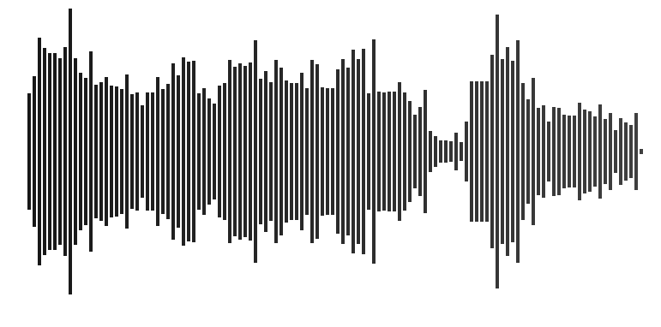
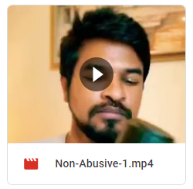
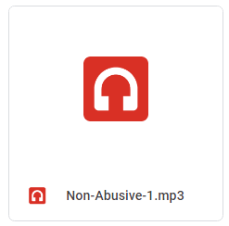
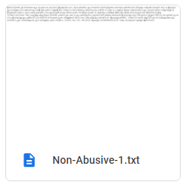
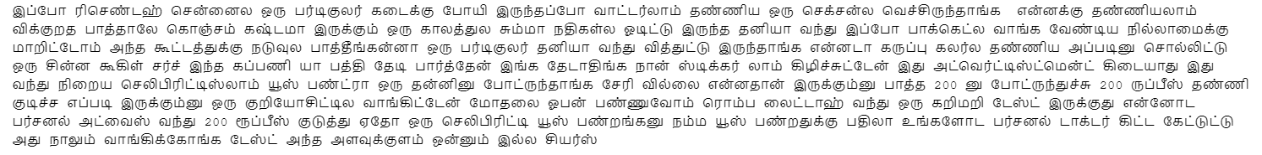
Sample

Slide 10
Dataset Description
Frame rate of videos | 900 per video
Format | mp4
Sampling Rate of Speech Signal | 16k Hz
Average Length of Text Data | 731
Maximum Length of Text Data | 1288
Minimum Length of Text Data | 174
Average Length of Video and Audio | 45 seconds
Maximum Length of Video and Audio | 1 minute
Minimum Length of Video and Audio | 30 seconds
Dataset | Train | Test | Validation
Video | 70 | 9 | 9
Notes:
Training and test split:
70 - ( 38 + 32)
18 - ( 9 + 9)

Slide 11
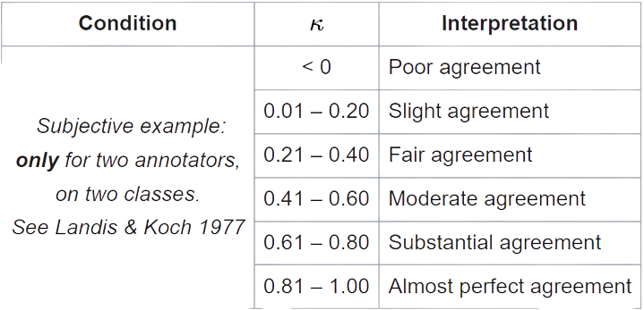
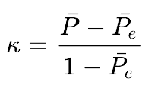
Fleiss Kappa
It is a statistical measure for assessing the reliability of agreement between a fixed number of raters when assigning categorical ratings to a number of items or classifying items.
Agreement can be thought of as follows, if a fixed number of people assign numerical ratings to a number of items then the kappa will give a measure for how consistent the ratings are. The kappa, k, can be defined as,
If the raters are in complete agreement then k=1. If there is no agreement among the raters (other than what would be expected by chance) then k<=0

Slide 12
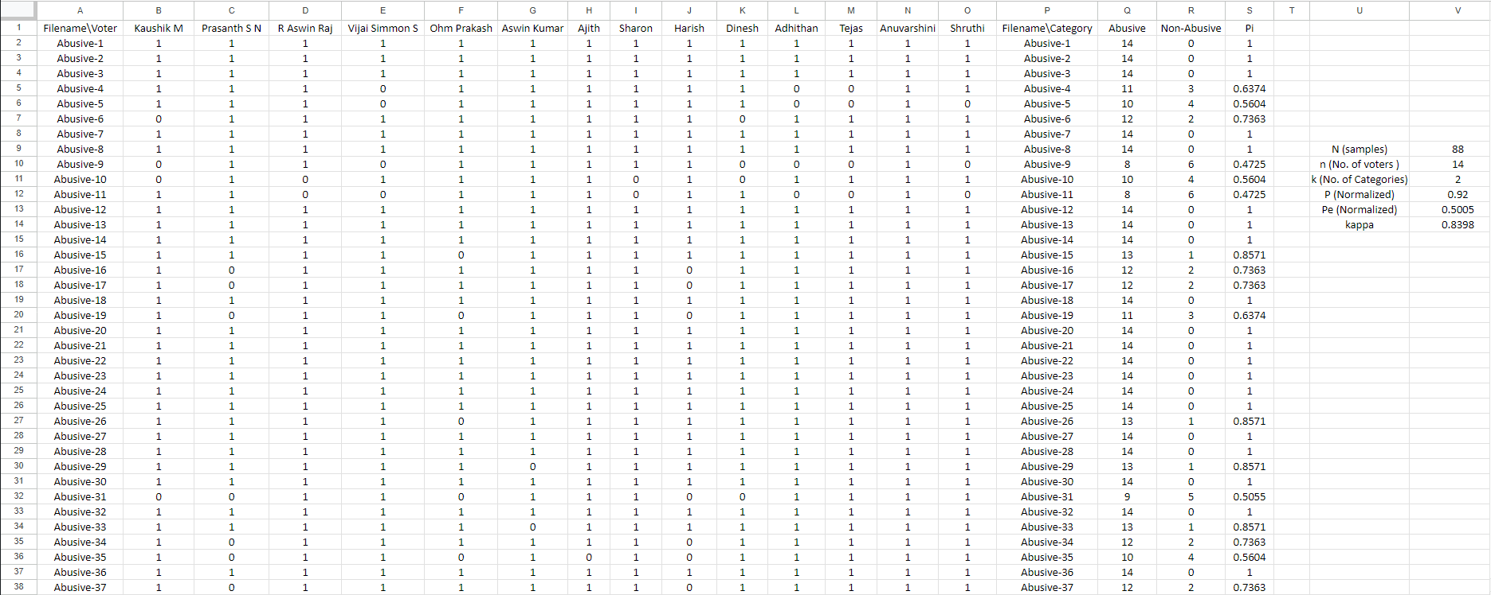
How to compute Fleiss Kappa
Link to the above spreadsheet: https://bit.ly/3M8NRWd

Slide 13
03
Methodology

Slide 14
Methodology
We started off with uni-modal approach where we used audio, video and text separately and create individual models for classification using various feature extraction techniques. Some of the techniques to be used are mentioned below:
Audio – Extraction of acoustic features using packages like LibROSA and openSMILE
Video – Extraction of visual features using CNN based models
Text – Extraction of textual features using TF-IDF and Experimenting with transformers based approach like BERT and LaBSE
Then we will move on to the multimodal approach where we concurrently use audio, video and text features to create multimodal based models.

Slide 15
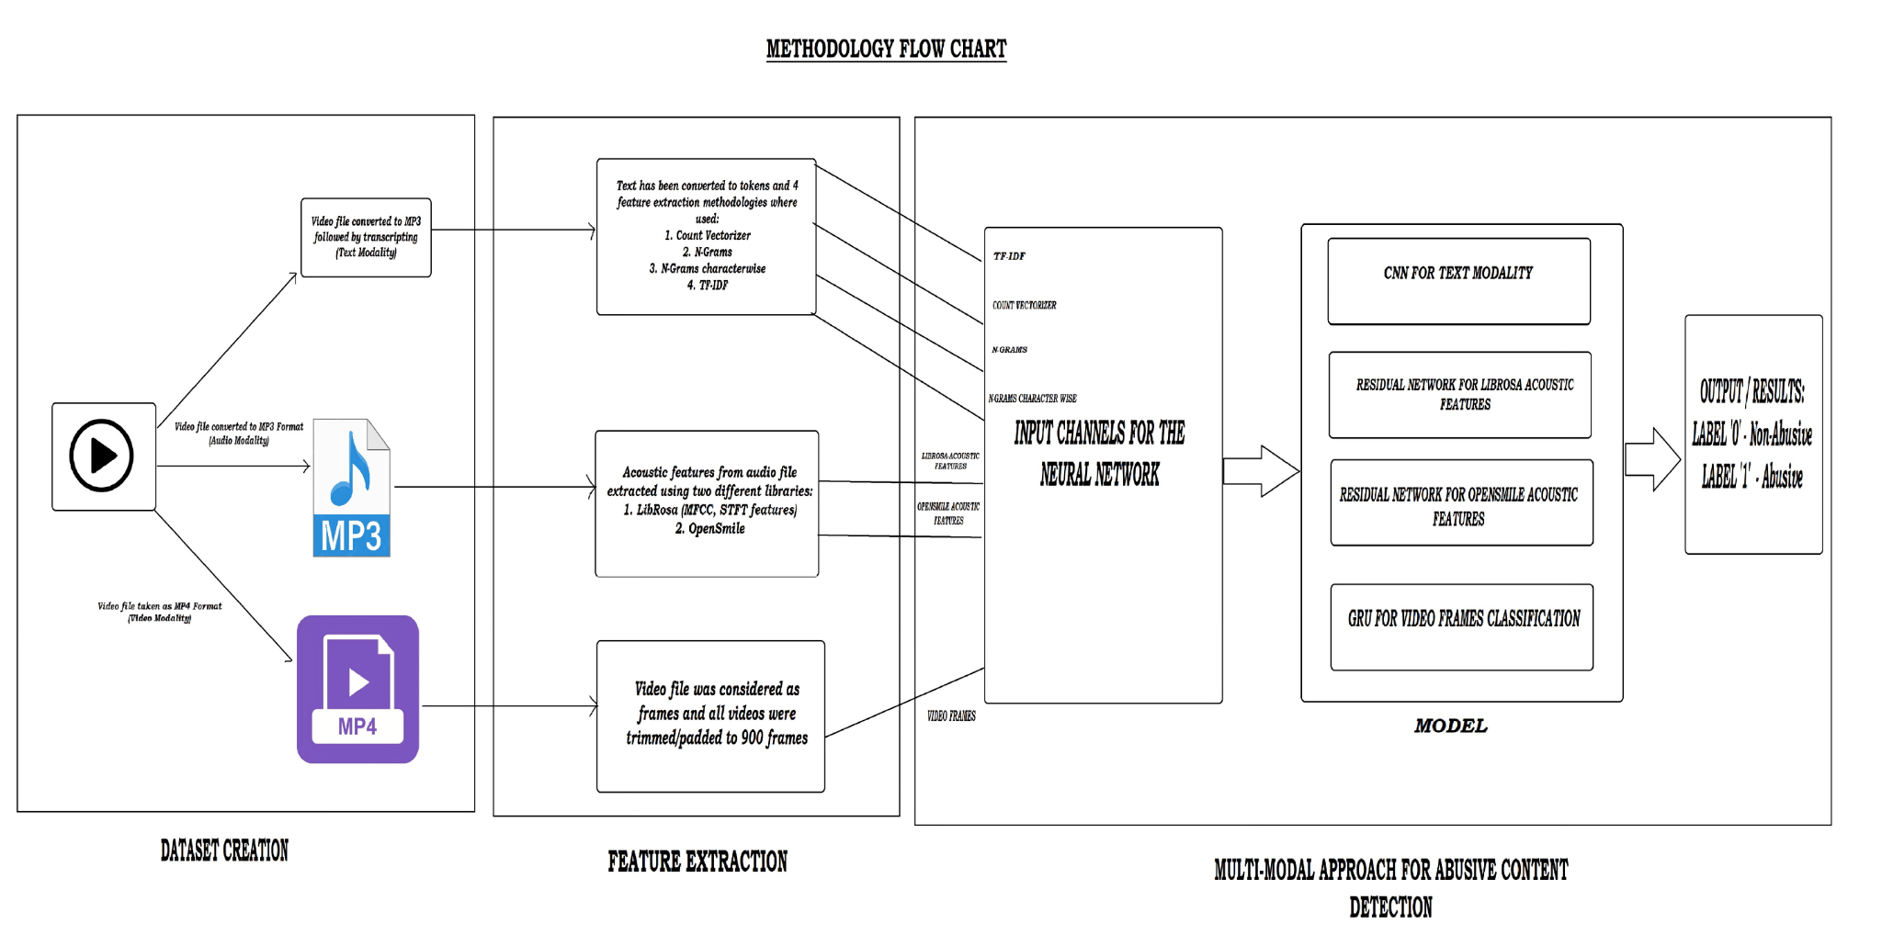

Slide 16
04
Preliminary Results

Slide 17
Audio Modality
OpenSmile (FeatureSet: ComParE_2016, FeatureLevel: Functionals)
Models | Accuracy | Precision | Recall | F1-Score
Logistic Regression {Penalty: l2, Solver: lbfgs} | 0.61 | 0.50 | 0.50 | 0.48
SVM {C: 1, Kernel: RBF} | 0.67 | 0.59 | 0.54 | 0.52
Random Forest {Criterion: Gini, n_estimator: 100} | 0.83 | 0.83 | 0.88 | 0.83

Slide 18
Audio Modality
OpenSmile (FeatureSet: eGeMAPSv02, FeatureLevel: Functionals)
Models | Accuracy | Precision | Recall | F1-Score
Logistic Regression {Penalty: L2, Solver: Saga} | 0.61 | 0.66 | 0.67 | 0.61
SVM {C: 100, Kernel:RBF} | 0.67 | 0.75 | 0.75 | 0.67
Random Forest {Criterion:Gini, n_estimator:100} | 0.67 | 0.69 | 0.71 | 0.66

Slide 19
Audio Modality
OpenSmile (FeatureSet: ComParE_2016, FeatureLevel: LowLevelDescriptor)
Models | Accuracy | Precision | Recall | F1-Score
Logistic Regression {Penalty: l2, Solver: lbfgs} | 0.78 | 0.80 | 0.83 | 0.77
SVM {C: 1, Kernel: RBF} | 0.61 | 0.73 | 0.71 | 0.61
Random Forest {Criterion: Gini, n_estimator: 100} | 0.94 | 0.93 | 0.96 | 0.94

Slide 20
Audio Modality
LibROSA(FeatureSet:MFCC, mel spectrogram, STFT)
Models | Accuracy Normal | Accuracy Scaled | Accuracy MinMax | Test Normal | Test Scaled | Test MinMax
K Neighbors Classifier | 0.72 | 0.50 | 0.50 | 0.72 | 0.50 | 0.50
SVC | 0.78 | 0.61 | 0.61 | 0.78 | 0.61 | 0.61
SVC-RBF Kernel | 0.78 | 0.44 | 0.61 | 0.78 | 0.44 | 0.61
Decision Tree Classifier | 0.61 | 0.28 | 0.5 | 0.61 | 0.28 | 0.50
Random Forest Classifier | 0.72 | 0.39 | 0.50 | 0.72 | 0.39 | 0.50
Logistic Regression | 0.72 | 0.39 | 0.50 | 0.72 | 0.39 | 0.50

Slide 21
Audio Modality
OpenSmile (FeatureSet: ComParE_2016, FeatureLevel: LowLevelDescriptor)
Models | Accuracy | Precision | Recall | F1-Score
Baseline Model | 0.55 | 0.73 | 0.63 | 0.53
Simple U Network | 0.77 | 0.76 | 0.76 | 0.77
Residual Network | NA | NA | NA | NA

Slide 22
Audio Modality
OpenSmile (FeatureSet: ComParE_2016, FeatureLevel: Functional)
Models | Accuracy | Precision | Recall | F1-Score
Baseline Model | 0.50 | 0.73 | 0.55 | 0.41
Simple U Network | 0.61 | 0.79 | 0.56 | 0.51
Residual Network | 0.66 | 0.81 | 0.62 | 0.61

Slide 23
Audio Modality
OpenSmile (FeatureSet: eGeMAPSv02, FeatureLevel: Functionals)
Models | Accuracy | Precision | Recall | F1-Score
Baseline Model | 0.55 | 0.58 | 0.57 | 0.55
Simple U Network | 0.61 | 0.60 | 0.60 | 0.61
Residual Network | NA | NA | NA | NA

Slide 24
Audio Modality
Librosa(FeatureSet:MFCC, mel spectrogram, STFT)
Models | Accuracy | Precision | Recall | F1-Score
Baseline Model | 0.77 | 0.75 | 0.85 | 0.75
Simple U Network | 0.77 | 0.75 | 0.85 | 0.79
Residual Network | 0.88 | 0.83 | 0.92 | 0.89

Slide 25
Audio Modality
DL Model:
LibROSA - Residual Network - Accuracy = 0.89
OpenSmile (ComParE_2016 with Low Level Descriptor) - Simple U Network - Accuracy = 0.77
ML Models:
LibROSA - SVM with RBF Kernel - Accuracy = 0.78
OpenSmile (ComParE_2016 with Low Level Descriptor)- Random Forest - Accuracy = 0.94

Slide 26
Text Modality
Logistic Regression
 | Accuracy | F1-score | Precision | Recall
One-Hot encoding | 0.94 | 0.947 | 1.000 | 1.000
TF-IDF | 0.94 | 0.952 | 1.000 | 1.000
TF-IDF n-grams | 0.83 | 0.870 | 0.990 | 0.988
TF-IDF char n-grams | 0.94 | 0.952 | 0.968 | 0.963
LaBSE | 0.94 | 0.94 | 0.95 | 0.94
Distiluse V1 | 0.56 | 0.36 | 0.28 | 0.50
Tamilion | 0.56 | 0.36 | 0.28 | 0.50
MuRIL | 0.56 | 0.36 | 0.28 | 0.50

Slide 27
Text Modality
Stochastic Gradient
 | Accuracy | F1-score | Precision | Recall
One-Hot encoding | 0.88 | 0.889 | 0.956 | 0.900
TF-IDF | 0.94 | 0.952 | 0.955 | 0.938
TF-IDF n-grams | 0.88 | 0.870 | 0.938 | 0.919
TF-IDF char n-grams | 0.83 | 0.842 | 0.944 | 0.887
LaBSE | 0.72 | 0.72 | 0.75 | 0.74
Distiluse V1 | 0.50 | 0.41 | 0.74 | 0.55
Tamilion | 0.44 | 0.31 | 0.22 | 0.50
MuRIL | 0.56 | 0.36 | 0.28 | 0.50

Slide 28
Text Modality
SVM
 | Accuracy | F1-score | Precision | Recall
One-Hot encoding | 0.88 | 0.909 | 0.917 | 0.875
TF-IDF | 0.94 | 0.952 | 0.955 | 0.938
TF-IDF n-grams | 0.83 | 0.870 | 0.885 | 0.812
TF-IDF char n-grams | 0.94 | 0.952 | 0.955 | 0.938
LaBSE | 0.78 | 0.78 | 0.79 | 0.79
Distiluse V1 | 0.78 | 0.78 | 0.78 | 0.78
Tamilion | 0.44 | 0.31 | 0.22 | 0.50
MuRIL | 0.56 | 0.36 | 0.28 | 0.50

Slide 29
Text Modality
Random Forest
 | Accuracy | F1-score | Precision | Recall
One-Hot encoding | 0.94 | 0.952 | 0.955 | 0.950
TF-IDF | 0.83 | 0.857 | 0.916 | 0.906
TF-IDF n-grams | 0.88 | 0.909 | 0.983 | 0.975
TF-IDF char n-grams | 0.88 | 0.900 | 0.962 | 0.956
LaBSE | 0.83 | 0.83 | 0.83 | 0.84
Distiluse V1 | 0.83 | 0.83 | 0.83 | 0.84
Tamilion | 0.56 | 0.36 | 0.28 | 0.50
MuRIL | 0.89 | 0.89 | 0.89 | 0.89

Slide 30
Text Modality
XGBoost
 | Accuracy | F1-score | Precision | Recall
One-Hot encoding | 0.94 | 0.952 | 1.000 | 1.000
TF-IDF | 1.00 | 1.000 | 1.000 | 1.000
TF-IDF n-grams | 0.83 | 0.842 | 0.875 | 0.875
TF-IDF char n-grams | 0.88 | 0.900 | 0.976 | 0.963
LaBSE | 0.78 | 0.78 | 0.79 | 0.79
Distiluse V1 | 0.78 | 0.78 | 0.78 | 0.78
Tamilion | 0.50 | 0.49 | 0.49 | 0.49
MuRIL | 0.89 | 0.89 | 0.90 | 0.90

Slide 31
Text Modality
Simple Transformers
 | Accuracy | F1-score | Precision | Recall
Tamillion | 0.94 | 0.94 | 0.95 | 0.95
MuRIL | 0.83 | 0.83 | 0.83 | 0.88
Notes:
P1: 1 - 7
P2: 8 - 10
P3: 11 - 12, 38 - 41
P4: 32 - 37
P5: 13 - 18
P6: 19 - 22
P7: 23 - 27
P8: 28 - 31

Slide 32
Text Modality
For One-Hot Encoding we can use XGBoost model for classification.
For TF-IDF, we can use XGBoost model (F1-score = 1.00)
For TF-IDF N-Grams, we can use Random Forest.
For TF-IDF N-Grams character wise, we can use Logistic Regression and SVM that offer with identical accuracy values.
When transformers were used to feature extraction and passed to ML models performed subpar whereas using simple transformers performed almost on par with models without using transformers.

Slide 33
Video Modality
Models | With Padding | Without Padding
CNN-RNN | 0.87 | 0.78
CNN-GRU | 0.72 | 1.00
CNN-LSTM | 0.89 | 0.67

Slide 34
MultiModal Results
Models | Training Accuracy | Validation Accuracy
MultiModal - Audio + Text | 0.88 | 0.88
MultiModal - Audio + Text + Video ( 1 channel per modality) | 0.57 | 0.77
MultiModal - Audio + Text + Video (Multiple Channel per modality) | 0.92 | 0.83

Slide 35
05
Target Outcomes

Slide 36
Target Outcomes
Several deep learning-based models for identifying videos containing abusive content have been developed by fusing the modalities of video, speech, and text to show the effective results.
In order to compare the efficiency of different models, several feature combinations from three different modalities will be taken into consideration. The effectiveness of several models will be evaluated, and the best outcomes from various feature combinations across three distinct modalities will be taken into account. Hence, these actions offer a long-term, scalable solution to this issue.
On successful implementation of this approach, it will be simple to analyse and delete damaging content, such as rude or hateful remarks or other instances of abusive language.
Now our initial target is to publish our work in reputed conference.

Slide 37
06
Competition Hosted

Slide 38
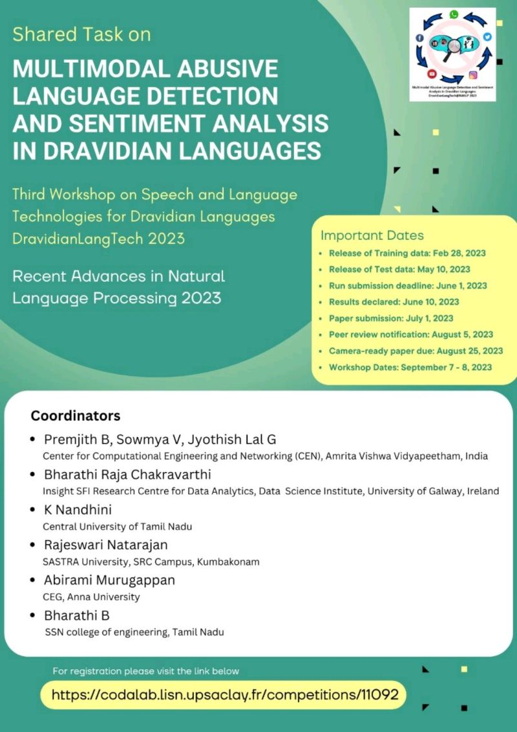
Competition Hosted
https://codalab.lisn.upsaclay.fr/competitions/11092

Slide 39
07
Future Works

Slide 40
Future Works
Upon the approval of the paper we are working towards the publishing our project in the Journal of Computational Social Science.
We are planning to automate the initial part of data collection and transcription.
We will also try to draft a paper based on the competition results.

Slide 41
Reference
[1] E. W. Pamungkas, V. Basile, and V. Patti, “Towards multidomain and multilingual abusive language detection: a survey,” Personal and Ubiquitous Computing, Aug. 2021, doi: 10.1007/s00779-021-01609-1.
[2] Chakravarthi, Bharathi Raja et al., “DravidianMultiModality: A Dataset for Multi-modal Sentiment Analysis in Tamil and Malayalam,” arXiv.org, 2021, doi: 10.48550/arXiv.2106.04853.
[3] R. Sharon, H. Shah, D. Mukherjee, and V. Gupta, “Multilingual and Multimodal Abuse Detection,” arXiv.org, 2022, doi: https://doi.org/10.48550/arXiv.2204.02263.
[4] Nasehatul Mustakim, Nusratul Jannat, Md. Maruf Hasan, and M. Hoque, “CUET-NLP@DravidianLangTech-ACL2022: Exploiting Textual Features to Classify Sentiment of Multimodal Movie...,” ResearchGate, Aug. 12, 2022. https://www.researchgate.net/publication/362644630_CUET-NLPDravidianLangTech-ACL2022_Exploiting_Textual_Features_to_Classify_Sentiment_of_Multimodal_Movie_Reviews (accessed Aug. 28, 2022).
[5] V. Lopes, A. Gaspar, L. A. Alexandre, and J. Cordeiro, “An AutoML-based Approach to Multimodal Image Sentiment Analysis,” 2021 International Joint Conference on Neural Networks (IJCNN), Jul. 2021, doi: 10.1109/ijcnn52387.2021.9533552.
[6]S. A. Abdu, A. H. Yousef, and A. Salem, “Multimodal Video Sentiment Analysis Using Deep Learning Approaches, a Survey,” Information Fusion, vol. 76, pp. 204–226, Dec. 2021, doi: 10.1016/j.inffus.2021.06.003.

Slide 42
Thank You

